Slide 1
Genesys Rules System Basic 3 Delivery Training April 2017

Slide 2

Delivery

Slide 3
CCS Technology Training Matrix – Basic Overview
Category | Level of Competency upon completion of level | Assessment | Training Type | Duration
Basic 1 | No hands-on experience and have Webster's understanding | None | PPT - 1 for all org | 1 hour
Basic 2 | Introductory understanding of all capabilities of the service; understand the requirements needed to "configure/build" the service | 3 question assessment after class | PPT - 1 for all org | 1.5 hours
Basic 3 | Perform basic configuration/development tasks; read/understand the requirements to identify any omissions | Know how to log in to non-prod Can perform a basic development step Save your work. | PPT - 1 deck for platform and 1 deck for delivery | 1 day
Basic 4 | Understanding upstream inputs; understanding monitoring; Basic problem solving capabilities; understand the requirements to be able to build a solution; can perform basic support and development tasks | Articulate what is passed to the service Articulate the monitoring; check logs basic understanding of what is in the log Basic understanding of common issues PASSES PROFICIENCY TEST Can be on-call Work tickets Do basic development | PPT - 1 deck for platform and 1 deck for delivery | 2 days
3

Slide 4
Agenda - Delivery
Definition
Diagram
Environment overviews including an overview SDLC for this service
A. Specific Hardware for each environment (where relevant)
Example issue/request and requirements
How To:
What do I need access to?
Where to I request access from?
How do I log in?
How do I build the solution to #4?
Assumptions/pre-requisites
Step-by-Step instructions
How do I save it?
How do I test it?
Who QA’s my work?
How do I migrate it to the next environment/prod?

Slide 5

Definition *From Basic 1&2*
Product Overview….
Genesys Rules System (GRS) provides the ability to develop, author, and evaluate business rules. A business rule is a piece of logic defined by a business analyst. These rules are evaluated in a Rules Engine based upon requests received from client applications such as intelligent Workload Distribution, Genesys Web Engagement and Genesys Conversation Manager.
GRS consists of three software components:
Genesys Rules Development Tool (GRDT)
Genesys Rules Authoring Tool (GRAT)
Genesys Rules Engine (GRE)
In Support of….
GRS is a component of the overall Genesys Framework and is used within the VCCEEM architecture. GRS is integrated into Genesys Orchestration Server scripts in use today by VCC applications such as; IVR (CPV/AAEP), ICM and VCCD.
GRE allows us to separate the Business Logic from the scripting logic, by externalizing the “Rule” into a separate process, allowing for greater flexibility and rapid change.
Supported By:
Vendor: Genesys
Optum Technology:
Von Dvoracek, Anthony Cimo – Technology Specialist / Product Development
David Fitzpatrick – Service Level Owner

Slide 6
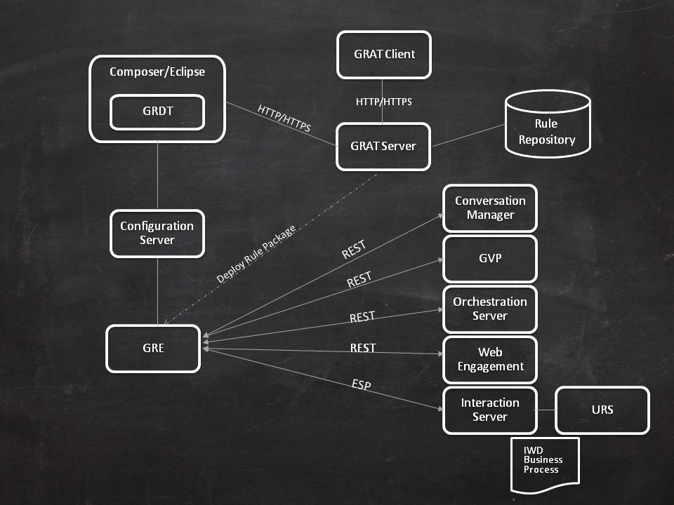
Product Diagram(s) *From Basic 1&2*

Slide 7
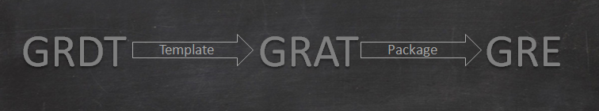
Product Diagram(s) *From Basic 1&2*
Genesys Rules Development Tool (GRDT) is an Eclipse plug-in that allows advanced users (business rules developers) to create templates that define the discrete rule conditions and actions that will comprise the rules. Each rule condition and action includes the plain-language label that the business rules author will see, as well as the rule language mapping that defines how the underlying data will be retrieved or updated. For each rule condition and action, the template developer decides what kind of data the rules author will be providing. Some examples include whether the input should be an integer value, a non-integer numeric value, a string, a selection from a pre-defined list, or a selection from a dynamic list.
Genesys Rules Authoring Tool (GRAT) is a browser-based application used by business analysts to create and edit packages of business rules based on the templates created in the Genesys Rules Development Tool.
Genesys Rules Engine (GRE) evaluates the rule packages (groups of rules). Rule packages are deployed to the Rules Engine by the Rules Authoring Tool. When a rule package has been deployed, Genesys applications will be able to request the Rules Engine to evaluate the logic that is defined in this rule package.

Slide 8
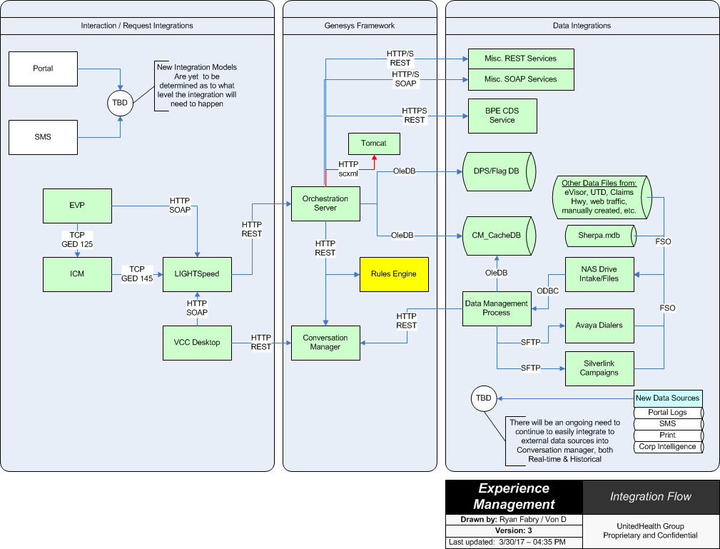
Environment overviews (SDLC)

Slide 9
Environment overviews (SDLC)
Genesys Rules System

Slide 10
Example issue/request and requirements
Displaying the IVR routing reason for call, along with an agent script on the VCCD Screen Pop- using the “Caller Intent” Rule.
The IVR prompts the member for the reason of their call, either through a Conversation Manager campaign prompt , or a Natural Language prompt.
The IVR stores a Level2Tag value in BPE indicating the reason for their call, such as “MemberID_General”.
The call is routed to the correct agent group where the call is delivered to a VCCD Agent.
The VCC Desktop Agent tool requests screen pop information from Orchestration Server.

Slide 11
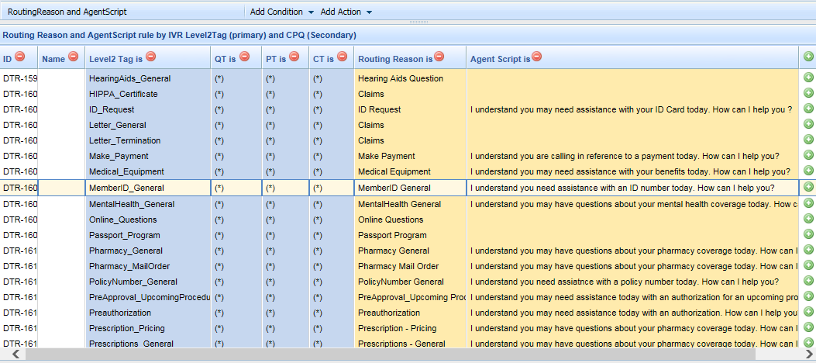
Example issue/request and requirements
Displaying the IVR routing reason for call, along with an agent script on the VCCD Screen Pop- using the “Caller Intent” Rule. (cont.)
Orchestration Server calls the “Caller Intent” rule in GRE to return the Routing Reason and Agent Script for the matching Level2Tag (passed as input).
GRE matches the Level2Tag input value configured in the Decision Rule table and returns the corresponding Routing Reason and Agent Script.

Slide 12
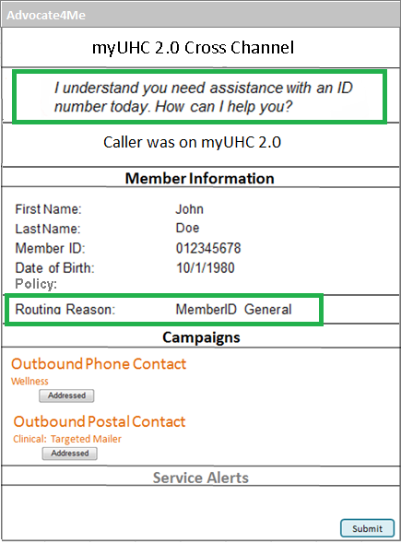
Example issue/request and requirements
Displaying the IVR routing reason for call, along with an agent script on the VCCD Screen Pop- using the “Caller Intent” Rule. (cont.)
Orchestration Server receives the Routing Reason and Agent Script from GRE and sends that back to VCCD where is displayed on the screen pop.

Slide 13
How To:
What do I need access to?
Global Groups:
Primary ID - ?
Secondary ID - ?
Where do I request access from?
Secure: https://secure.uhc.com/
How do I log in?
Log into the Genesys Rules Authoring Tool (GRAT) using Internet Explorer.
Endpoints:
Dev/Test - http://apsed1266.ms.ds.uhc.com:8080/genesys-rules-authoring/login.jsp
Stage - http://orch-stage-grat:9070/genesys-rules-authoring/login.jsp
Production - http://orch-prod-grat:9070/genesys-rules-authoring/login.jsp
How do I build the solution to #4?
Assumptions/pre-requisites
Genesys Composer
Eclipse IDE – Mars Version 2.0
JDK 1.8.0_51
Genesys Composer Plug-In Version 8.1.400.36 (available through the App Store)
Genesys Rules Development Tool (GRDT) Plug-In
Mozilla FireFox and RESTClient Add-On installed. Mozilla FireFox 38.0.1 is available from the App Store. Once installed the RESTClient can be installed from the Tools / Add-ons Menu. Search for RESTClient and install.

Slide 14
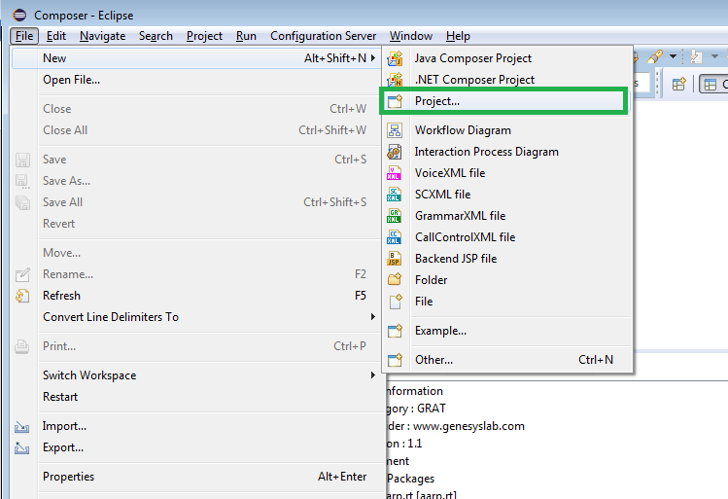
How To: (cont.)
How do I build the solution to #4?
Step-by-Step instructions
Open Eclipse
Click File → New → Project

Slide 15
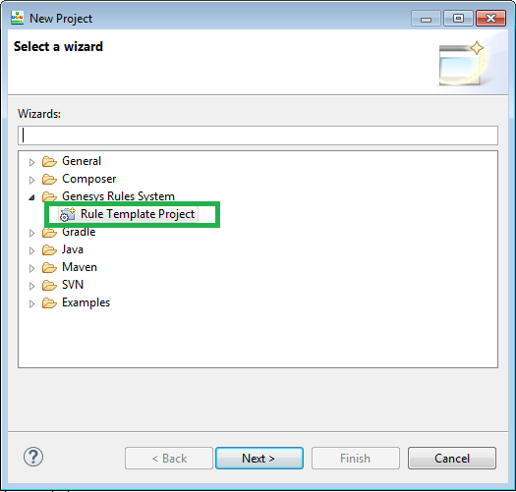
How To: (cont.)
The New Project window will open. Expand the “Genesys Rules System” folder and select the Rule Template Project.

Slide 16
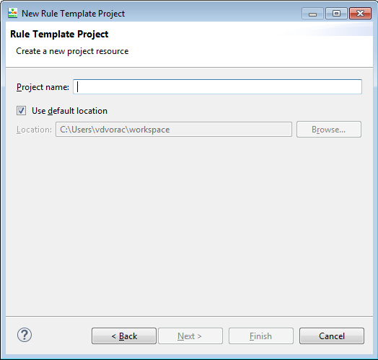
How To: (cont.)
With the Rule Template Project selected, press Next.

Slide 17
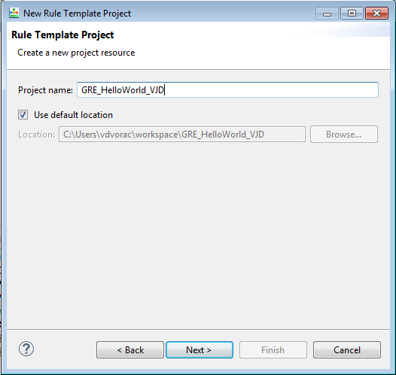
How To: (cont.)
Provide a name for the Project. Name it “GRE_HelloWorld_” + Your Initials. I named my project “GRE_HelloWorld_VJD” below. Press Next.

Slide 18
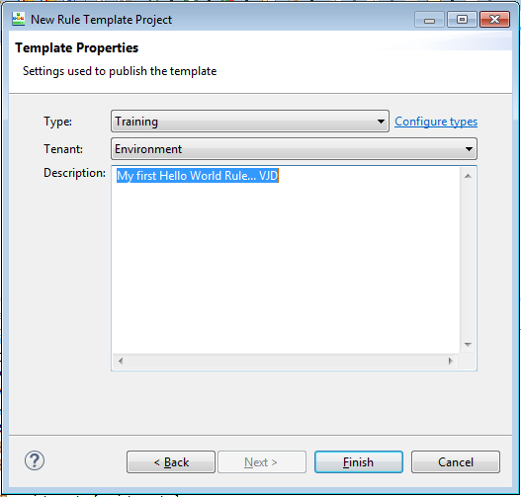
How To: (cont.)
Change the Type from “default” to “Training”, then provide a Description for your Hello World Rules Project. Press Finish.
The “Type” identifies how templates are grouped when published to GRAT.
All the HelloWorld GRE rules will be grouped underneath “Training”.

Slide 19
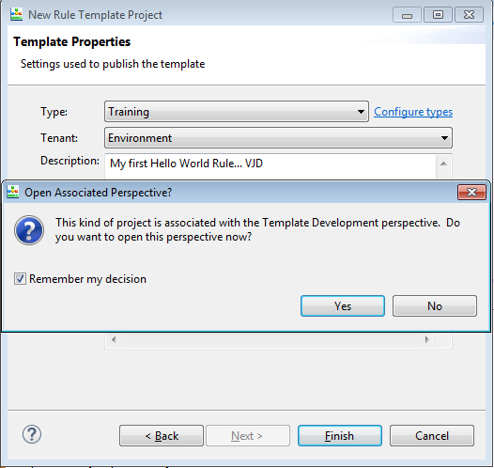
How To: (cont.)
If you’re presented with the below pop-up message, check the “Remember my decision” checkbox and press Yes.

Slide 20
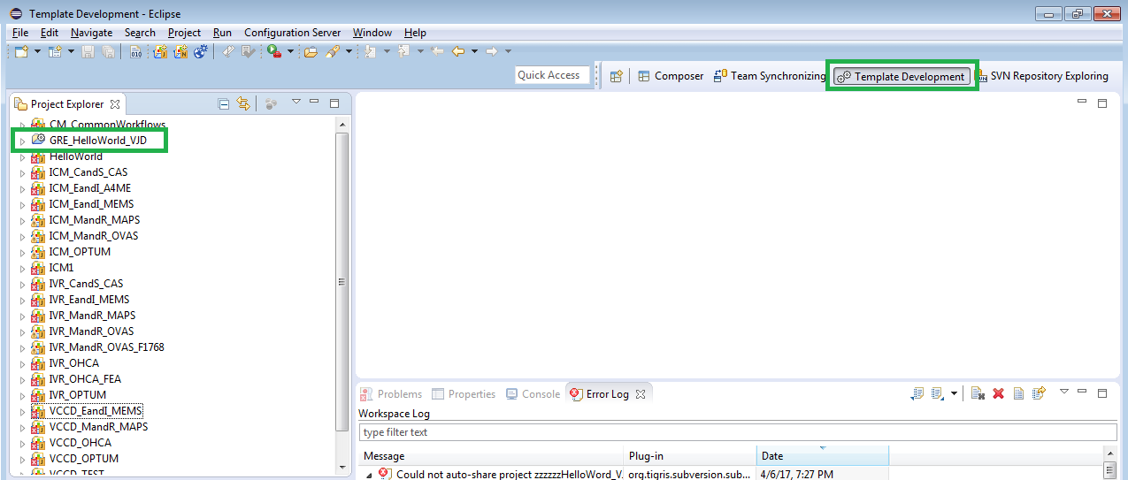
How To: (cont.)
A new Rule Template Project will be created with the “Template Development” perspective opened.

Slide 21
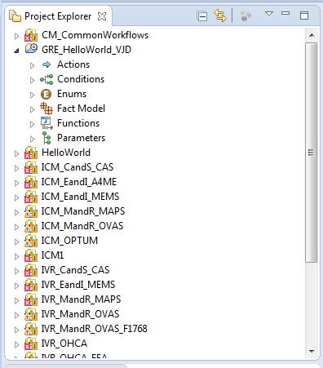
How To: (cont.)
Locate the GRE_HelloWorld project in the Project Explorer window on the left and expand the project to expose the items underneath.

Slide 22
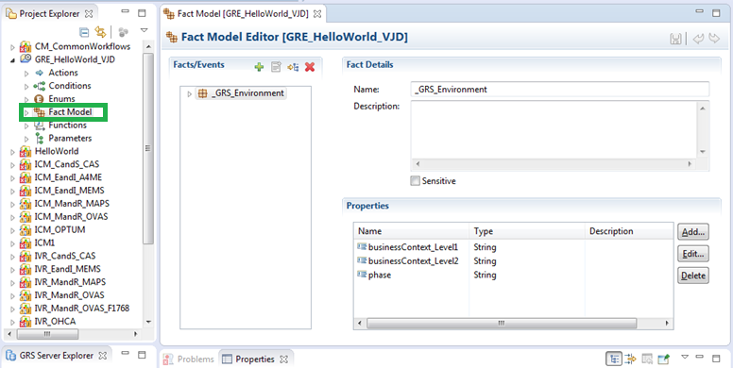
How To: (cont.)
Let’s start with defining the Fact Models for our HelloWorld rule. Double-click on the Fact Model object in the project

Slide 23
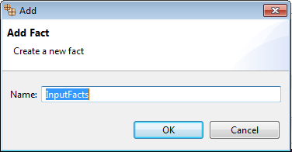
How To: (cont.)
The Fact Models section is where we define the Inputs and Outputs to our Rule. We will define an Input Fact to hold our input variables, and a Response Fact to hold our output (response) variable. Facts can contain one or more “properties” (inputs/outputs).
By default every Genesys Rules Template has a _GRS_Environment fact. This is a Genesys requirement, so we’ll leave this alone.
Starting with our rule’s inputs, press the sign located on the Facts/Events title bar to open the Add Fact prompt. Name the fact “InputFacts”, press OK.

Slide 24
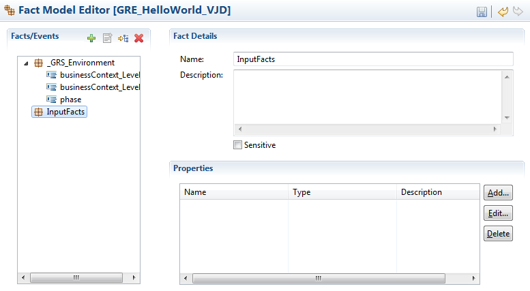
How To: (cont.)
A new InputFacts fact model has now been added. Next we’re going to add a description and 2 Input Properties; a boolean flag and a message string, after all this is a rule so we need to add a little logic to our Hello World rule.
We’ll use the boolean flag to trigger our “Hello World” response. If the boolean flag is false, then we’ll return the message “Sorry, but the Input Flag was false!”. We’ll use the message string to personalize our Hello message. We’ll build the rule to send back a personalized Hello message when the message string matches our first name.

Slide 25
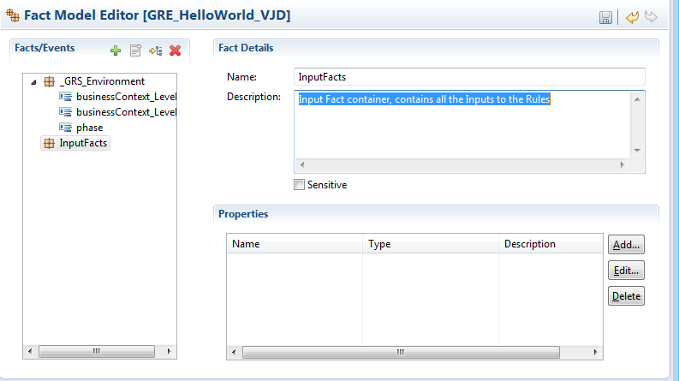
How To: (cont.)
With the InputFacts selected in the Facts/Events section, add the text “Input Fact container, contains all the Inputs to the Rules” to the Fact Details Description section.

Slide 26
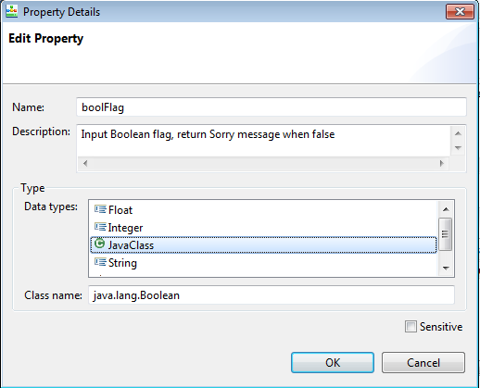
How To: (cont.)
Now add the Boolean Flag property, select the Add button in the Properties section. Name the property “boolFlag”, add the text description “Input Boolean flag, return Sorry message when false”, select JavaClass from the available Data Types, and add “java.lang.Boolean” to the Class Name section. (Note, the Boolean data type is not an available data type to select, so we must define it in the Class Name field)

Slide 27
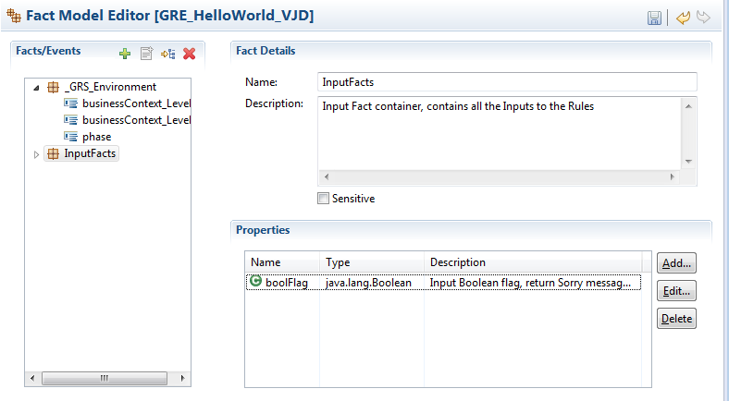
How To: (cont.)
Select OK

Slide 28
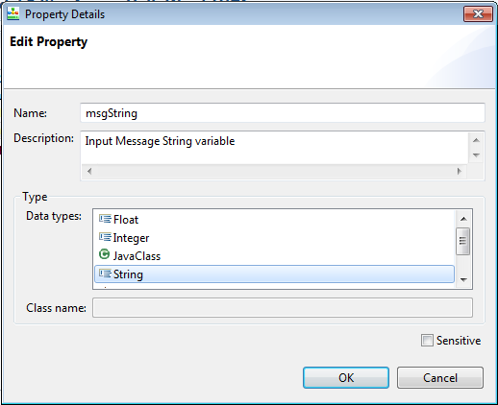
How To: (cont.)
Now add the Message String property, select the Add button in the Properties section. Name the property “msgString”, add the text description “Input Message String variable”, select String from the available Data types.

Slide 29
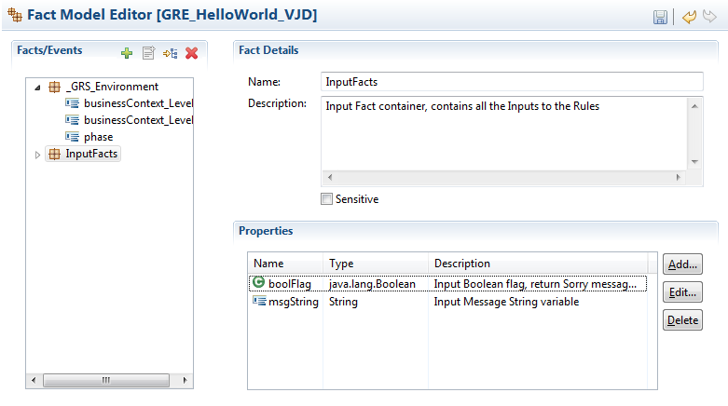
How To: (cont.)
Select OK.
Save your changes using either the Save Icon or the File → Save menu

Slide 30
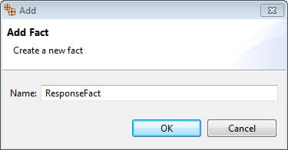
How To: (cont.)
Now let’s add a Response Fact, which will hold our response message; i.e. “Hello World!”.
On the Facts/Events title bar, press the sign to add a new Fact. Name the fact “ResponseFact”, press OK.

Slide 31
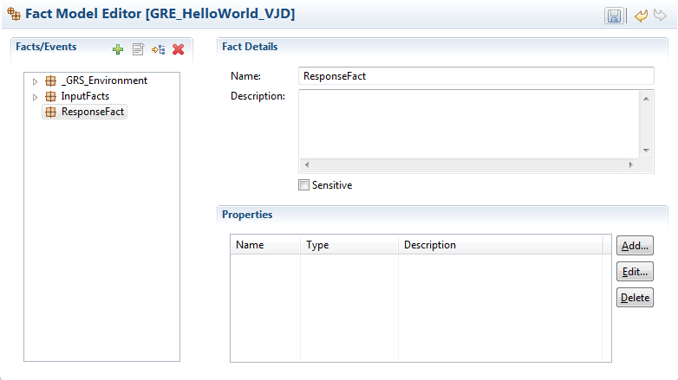
How To: (cont.)
A new ResponseFact fact model has now been added. Next we’re going to add a description and 1 Input Property; a single message string.

Slide 32
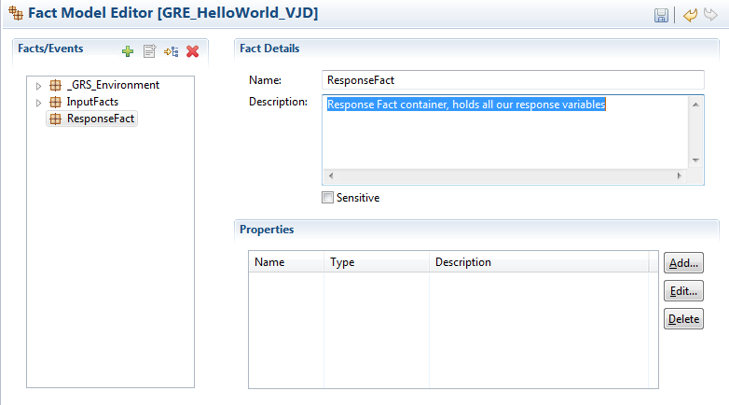
How To: (cont.)
With the ResponseFact selected in the Facts/Events section, add the text “Response Fact container, holds all our response variables” to the Fact Details Description section.

Slide 33
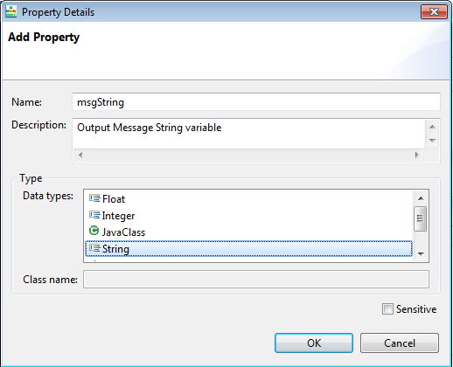
How To: (cont.)
Now add the Message String property, select the Add button in the Properties section. Name the property “msgString”, add the text description “Output Message String variable”, select String from the available Data types.

Slide 34
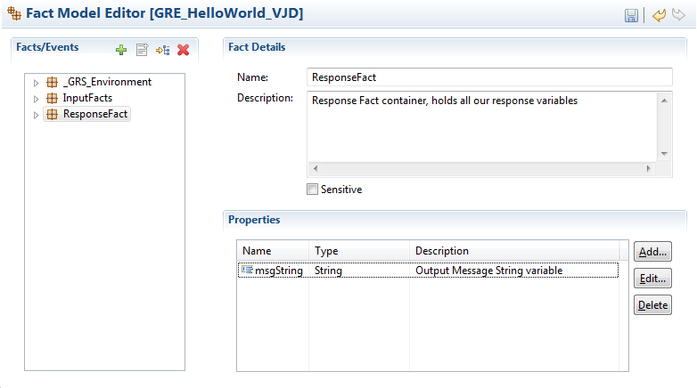
How To: (cont.)
Select OK.
Save your changes using either the Save Icon or the File → Save menu

Slide 35
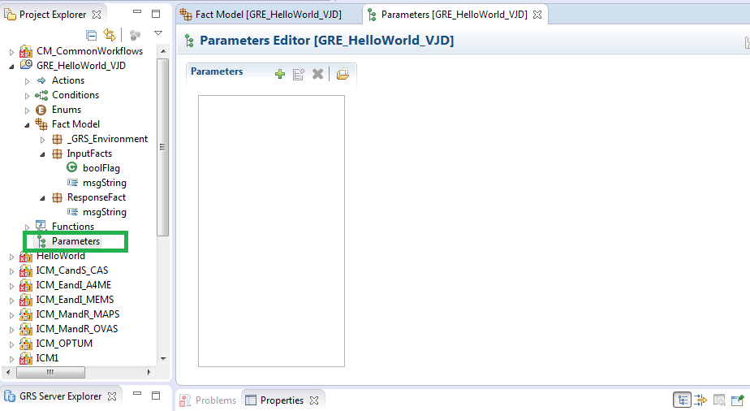
How To: (cont.)
We have defined the inputs and outputs to our Rule. Now we need to map these inputs/outputs to Rule Parameters so that we can use them within GRAT to author our rule later. From the Project Explorer Window, double-click the Parameters item to open the Parameters Editor window.

Slide 36
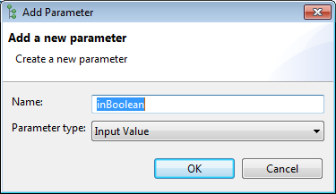
How To: (cont.)
We’ve defined 3 Facts (2 Inputs and 1 Output), so we need to define 3 Parameters to map to these facts. We’ll start with a parameter that will be mapped to the boolFlag Input Fact first.
On the Parameters title bar, press the sign to add a new Parameter. Name the parameter “inBoolean”, keep the Parameter Type as “Input Value”, press OK.

Slide 37
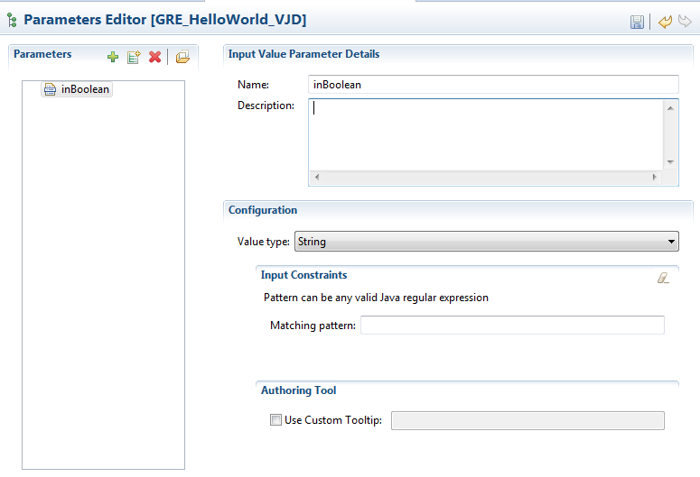
How To: (cont.)
A new inBoolean Parameter has now been added. Next we’re going to add a description and define the data type.

Slide 38
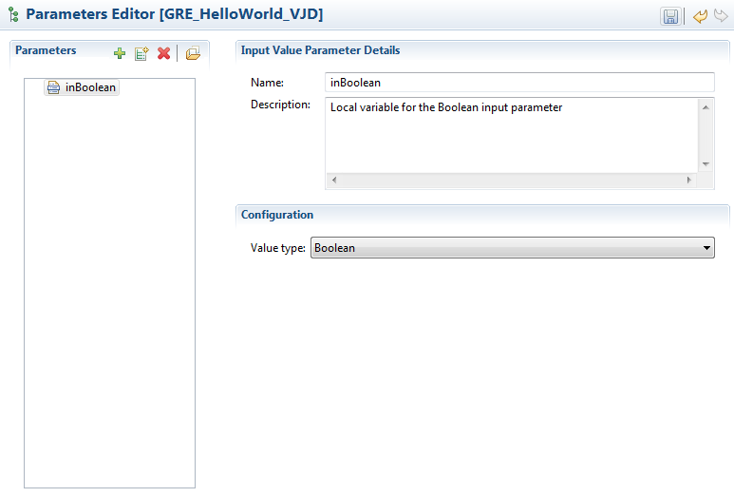
How To: (cont.)
Add the text description “Local variable for the Boolean input parameter”, select Boolean from the available Value Types.

Slide 39
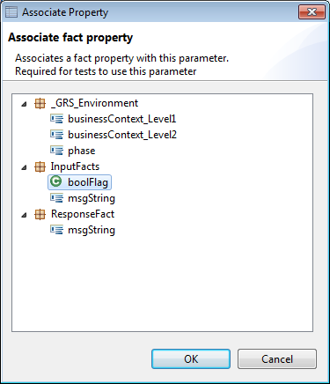
How To: (cont.)
Next, we are going to associate this parameter with the boolFlag input fact.
Select the icon from the Parameters title bar. Select the boolFlag item underneath the InputFacts section, press OK.

Slide 40
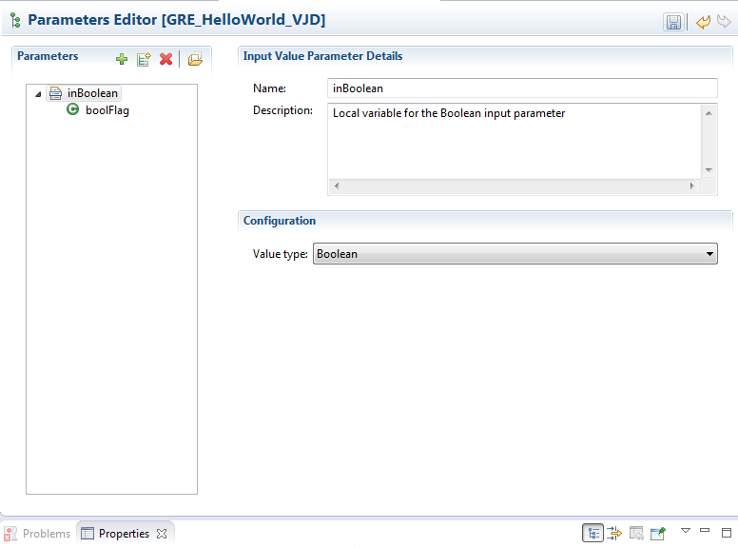
How To: (cont.)
By associating our inBoolean Parameter to the boolFlag Input Fact, we have created the mapping necessary for testing our rule within GRAT.
“GRAT maps the parameter values to the underlying fact model developed by the template developer, who understands the relationship between the parameters and the fact model. So, for rule testing to operate correctly, template developers must map parameters back to the underlying fact model.”

Slide 41
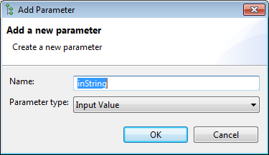
How To: (cont.)
Next we’ll map a parameter to the msgString Input Fact.
On the Parameters title bar, press the sign to add a new Parameter. Name the parameter “inString”, keep the Parameter Type as “Input Value”, press OK.

Slide 42
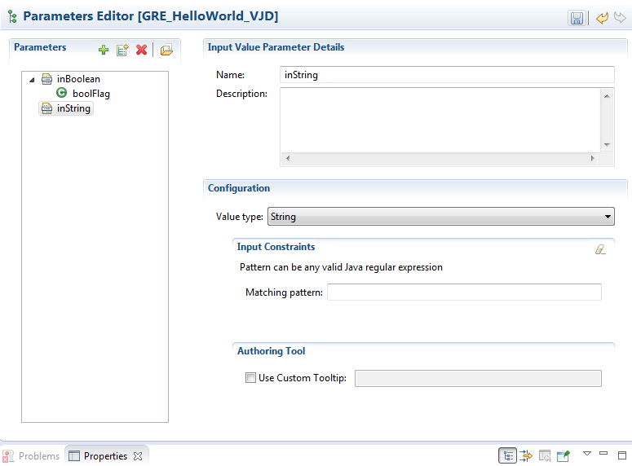
How To: (cont.)
A new inString Parameter has now been added. Next we’re going to add a description, define the data type and this time give it a “Tool Tip” to provide context around the use of the parameter to the rule author within GRAT.

Slide 43
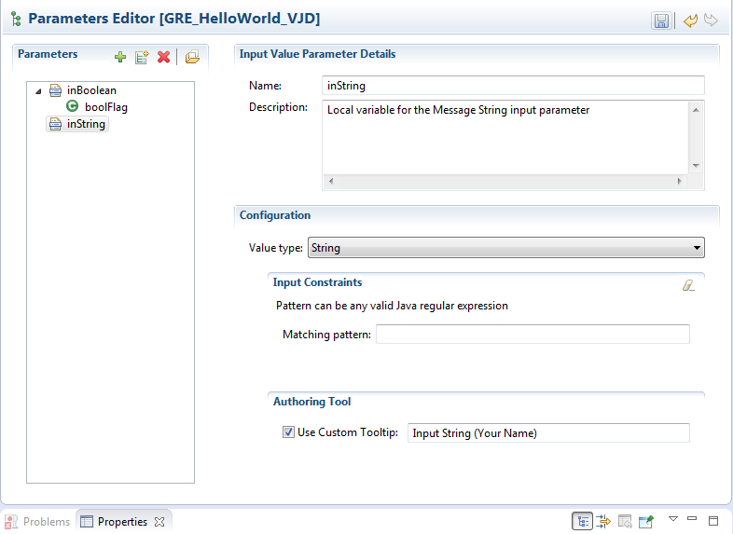
How To: (cont.)
Add the text description “Local variable for the Message String input parameter”, select String from the available Value Types, check the “Use Custom Tooltip” check box and add the text “Input String (Your Name)” to the tooltip textbox.

Slide 44
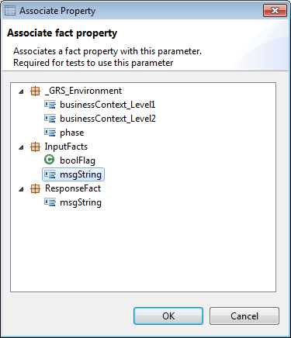
How To: (cont.)
Next, we are going to associate this parameter with the msgString input fact.
Select the icon from the Parameters title bar. Select the msgString item underneath the InputFacts section, press OK.

Slide 45
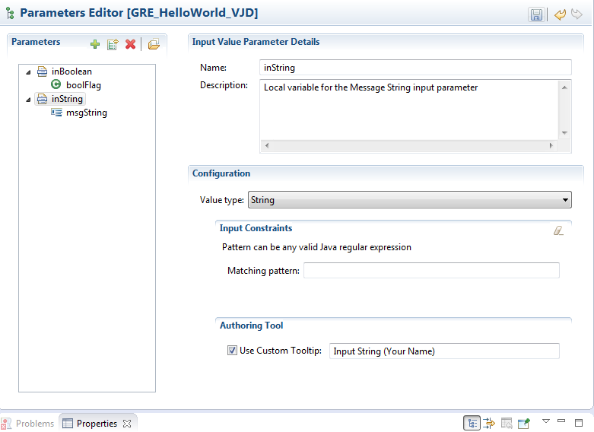
How To: (cont.)
The inString Parameter is now associated to the msgString Input Fact.

Slide 46
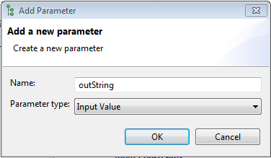
How To: (cont.)
Next we’ll map a parameter to the msgString fact within our ResponseFact fact model.
On the Parameters title bar, press the sign to add a new Parameter. Name the parameter “outString”, keep the Parameter Type as “Input Value”, press OK.

Slide 47
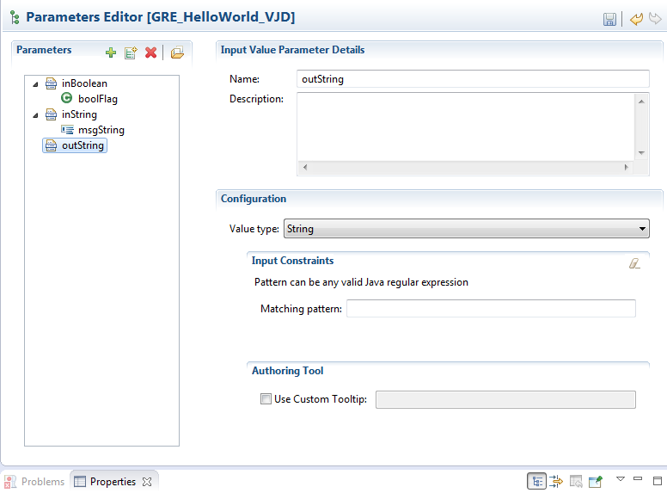
How To: (cont.)
A new outString Parameter has now been added. Next we’re going to add a description, define the data type and give it a “Tool Tip” to provide context around the use of the parameter to the rule author within GRAT.

Slide 48
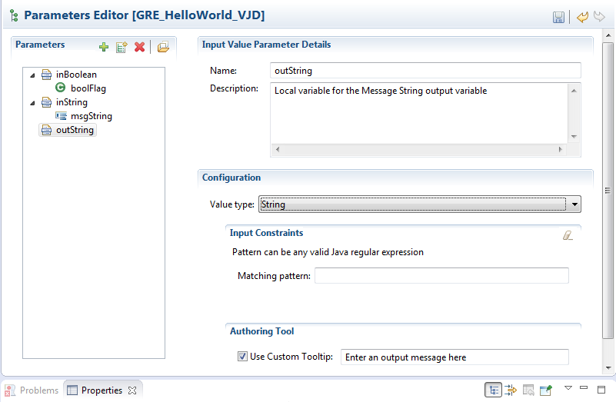
How To: (cont.)
Add the text description “Local variable for the Message String output variable”, select String from the available Value Types, check the “Use Custom Tooltip” check box and add the text “Enter an output message here” to the tooltip textbox.

Slide 49
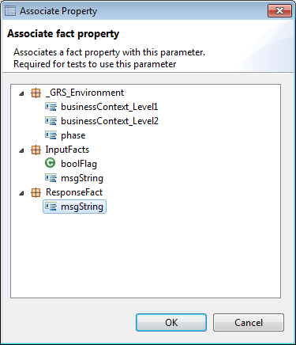
How To: (cont.)
Next, we are going to associate this parameter with the msgString output response fact.
Select the icon from the Parameters title bar. Select the msgString item underneath the ResponseFact section, press OK.

Slide 50
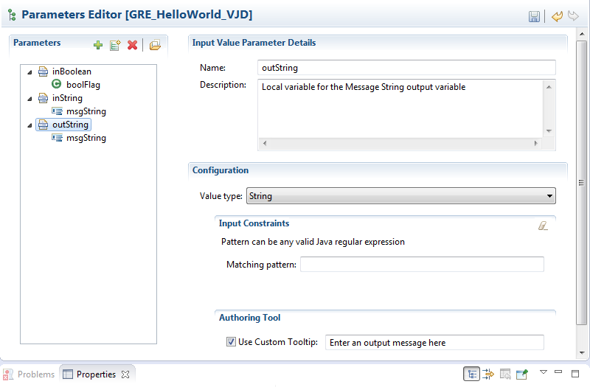
How To: (cont.)
The outString Parameter is now associated to the msgString Response Fact.

Slide 51
How To: (cont.)
Save your changes using either the Save Icon or the File → Save menu
We have defined the inputs and outputs to our Rule as Facts within the Fact Model, and we’ve identified the Parameters to be used for mapping these inputs/outputs. Now we need to define the Rule Language Mapping between the Fact Models and the Parameters.
The InputFacts, which contain our input parameters, are configured as a Condition. So we will define the Rule Language Mapping for our inputs within the Conditions editor.
The ResponseFact, which contains our single output variable, is configured as an Action. So we will define the Rule Language Mapping for our output/response within the Actions editor.

Slide 52
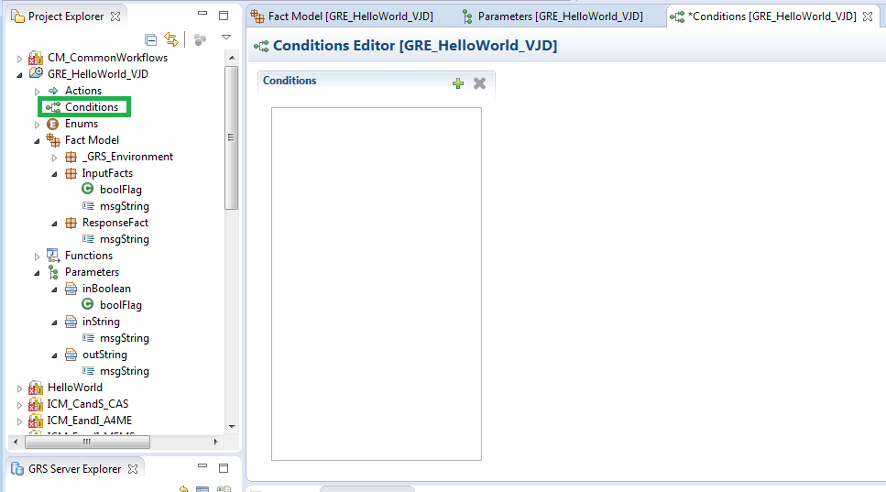
How To: (cont.)
We’ll start with the InputFacts and the Conditions Editor. From the Project Explorer Window, double-click the Conditions item to open the Conditions Editor window

Slide 53
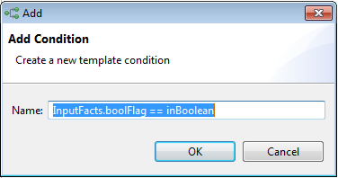
How To: (cont.)
Let’s start with creating the Rule Language Condition for the boolFlag Input Fact.
On the Conditions title bar, press the sign to add a new Condition. Name the condition “InputFacts.boolFlag == inBoolean”, press OK.

Slide 54
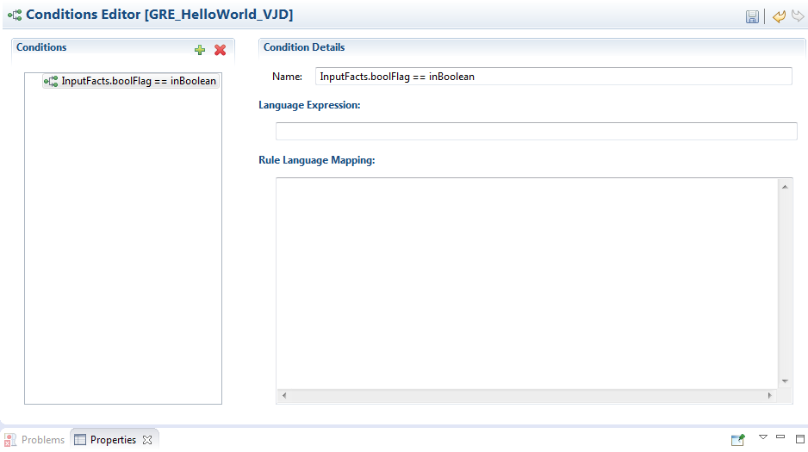
How To: (cont.)
A new Condition has been created. Now we need to create the Language Expression and Rule Language Mapping for the boolFlag input condition.

Slide 55
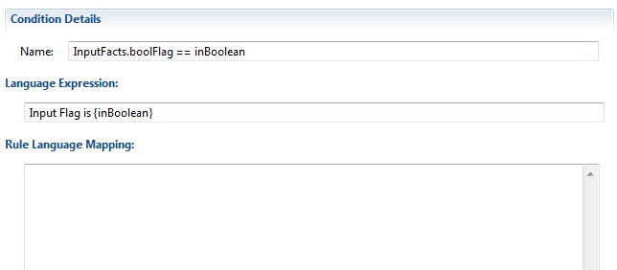
How To: (cont.)
The Language Expression is “The plain language expression of the condition that the rule author sees when constructing a business rule in the Rules Authoring Tool”. While the expression is “plain language” it also references our Parameter objects within the expression. Parameters are referenced by their name surrounded by curly brackets.
Add the text “Input Flag is {inBoolean}” to the Language Expression text box.

Slide 56
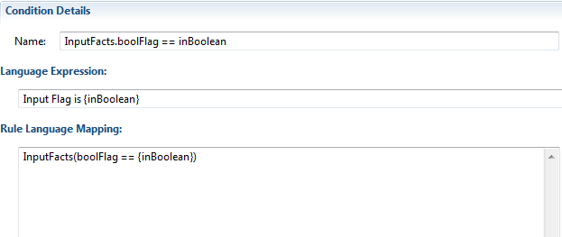
How To: (cont.)
The Rule Language Mapping is “The condition expressed in code.” Genesys Rules System uses the 5.1 Drools Rule Language. This is where we add the logical expression between our Input Fact and our Parameter.
The Rule Language Mapping is not visible to the business user when they are authoring rules in the GRAT. Instead, the rule authors will see the Language Expression that the rule template developer enters.
Add the text “InputFacts(boolFlag == {inBoolean})” to the Rule Language Mapping text area.

Slide 57
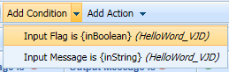
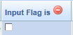
How To: (cont.)
Great, so we added the Language Expression and the Language Rule Mapping to our boolFlag Input Condition- but what exactly does this mean?
When we’re done with our template and we publish it to GRAT, we can then author (build) our rule. The Language Expression of “Input Flag is {inBoolean}” will be the user friendly text the authors will see within GRAT.
Here’s a sneak peak of how it’ll look.
When added to a decision table, the {inBoolean} parameter is automatically converted to a checkbox (based on the Boolean data type).
This allows the rule author to simply check the box for True and un-check it for False. Had the data type for our parameter been a String, then a Textbox would have been displayed for the rule author to enter free-form text instead.
The “InputFacts(boolFlag == {inBoolean})” Language Rule Mapping we entered is the Drools code that performs the logical comparison of our InputFacts\boolFlag value to the inBoolean parameter from the rule.

Slide 58
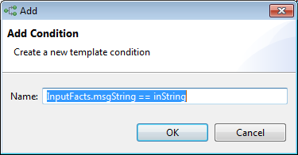
How To: (cont.)
Let’s continue with adding a Rule Language Condition for the msgString Input Fact.
On the Conditions title bar, press the sign to add a new Condition. Name the condition “InputFacts.msgString == inString”, press OK.

Slide 59

How To: (cont.)
A new Condition has been created for our msgString input fact. Now we need to create the Language Expression and Rule Language Mapping for the boolFlag input condition.

Slide 60

How To: (cont.)
Add the text “Input Message is {inString}” to the Language Expression text box and the text “InputFacts(msgString == "{inString}")” to the Rule Language Mapping text area. Notice that because our parameter is a string we must surround the {inString} parameter in double-quotes.

Slide 61

How To: (cont.)
Save your changes using either the Save Icon or the File → Save menu
We finished with defining the Conditions to our rule, now we need to define the Action(s). From the Project Explorer Window, double-click the Actions item to open the Actions Editor window.

Slide 62

How To: (cont.)
Our rule will have a single response item- our Hello World string. So we only need to add a single Action to map the outString parameter to the msgString variable of our ResponseFact.
Click the sign to add a new Action. Name the condition “Assign ResponseFact.msgString = outString”, press OK.

Slide 63

How To: (cont.)
A new Action has been created. Now we need to create the Language Expression and Rule Language Mapping for the msgString output action.
Add the text “Output Message is {outString}” to the Language Expression textbox and add the text “$ResponseFact.msgString="{outString}"” to the Rule Language Mapping text area.

Slide 64

How To: (cont.)
Save your changes using either the Save Icon or the File → Save menu
Your project should now look something like the below… with an Action, Conditions, Fact Models and Parameters all defined.

Slide 65

How To: (cont.)
We are now finished with the Rule Template. We created our Fact Models, our Rule parameters and the Language Mapping between them. The next step is to publish the Template to the GRAT server where we can begin “authoring” our rule.
With the GRE_HelloWorld project selected in the Project Folder, select Project → Publish from the menu bar.

Slide 66



How To: (cont.)
Hopefully the Publish Template Wizard will appear like the image on the left below, but if by chance your image looks more like the one on the right, then you’ll need to refresh your connection to the GRAT server.
* If you need to refresh your connection, go to the GRS Server Explorer Window underneath the Project Explorer window and press the refresh icon and retry the previous Publish step.

Slide 67

How To: (cont.)
Select the Next button and add the optional comment to the Publish Comment section. This comment will be carried forward to GRAT and can be used to communicate changes to rule authors between template modifications.

Slide 68


How To: (cont.)
Select Finish.
Select OK

Slide 69

How To: (cont.)
The Rule has successfully been published to GRAT and is now ready for authoring. We’re done with Composer, so now we’ll move onto GRAT and we access that through a web browser.
Log onto the GRAT server in Dev:
URL: http://apsed1266.ms.ds.uhc.com:8080/genesys-rules-authoring/login.jsp
User: default
Password: password

Slide 70

How To: (cont.)
Genesys is a multi-tenant framework, allowing for multiple tenants to occupy and run in their own space. Currently we have a single tenant configured named Environment. Under the Environment tenant we have our “Basic 3 Training” business structure. This is where we will be creating our rule.

Slide 71

How To: (cont.)
Expand the Basic 3 Training item and click on the “New Rule Package” item.

Slide 72
How To: (cont.)
Now we’re going to create our new Rule Package by giving it a Package Name, Business Name, Description and assign our rule Template to it.
The Package Name for our Rule is actually compiled into a Java package and therefor must follow the Java package naming convention. It must be all lower-case and cannot start with a number. Typically package names begin with the reverse of a companies domain name, like com.optum.basic3_training. We’re going to simplify this and just use basic3. plus our template name.
The Business Name is the user-friendly version of our Rule Package name and is what will display as the Rule Name within our Basic 3 Training Business Segment. Here we will use a Proper text to easily identify our Rule Package from the rest.
The Package Type identifies the type of Templates available to us in our package. If you’re recall back on slide 18, we selected the “Training” type for our Template. By selecting a Package Type of “Training” here, we will be able to see our Template, and all other Templates of type “Training”.

Slide 73

How To: (cont.)
Let’s go ahead and finish saving our new Package. Add the text “basic3.helloworld_vjd” to the Package Name (remember to change VJD to your initials). Next add the user friendly Business Name “Hello World – VJD”, again remembering to change VJD to your initials. If “Training” is not selected as the Package Type, select it now. Give a brief description of the Rule Package similar to below, and lastly locate and select your Template from the list of available Training templates below.

Slide 74

How To: (cont.)
Select Save
A new project has now been added underneath the “Basic 3 Training” Business Segment. Now we can begin “authoring” our rule.

Slide 75

How To: (cont.)
To being building the rule, click on the Rule tab

Slide 76

How To: (cont.)
There are 2 options when building a rule; a decision table and a linear rule. Decision tables are tabular rules, very much like an excel spreadsheet, and are evaluated top-down. Linear rules are more logical representations of a rule expressed in the format of When Logic is True Then Do Action…
We’ll be building our rule as a decision table. To get started, click on the “New Decision Table” option.

Slide 77

How To: (cont.)
A new Decision Table Rule be added to the view. There are 2 required properties for a new rule, the Name and the Phase. The Name should be a unique Rule name within the current Rule Package. Currently there’s only a single Phase option to select and that’s the Asterisk *. Give the new rule a name, description and select * for the Phase.

Slide 78

How To: (cont.)
Add the text “Hello World Rule” to the Name field, “Hello World Decision Table Rule” to the optional Description field, and select * from the Phase drop down.
“Hello World Rule” will be added below after selecting *

Slide 79


How To: (cont.)
Now that we have added a Decision Table to our rule, we can fill in our rule items. If you’ll recall when we built our Rule Template we configured Conditions and a single Action. The Conditions were mapped to our Inputs and the Action was mapped to output.
Add both of the Conditions and the Action to the rule table using the Add buttons.

Slide 80


How To: (cont.)
With our Conditions and Actions added your decision table should look like the below.
Click the green down arrow to add a new row to the table.

Slide 81

How To: (cont.)
We’re going to add a total of 3 rows to our decision table. The first row will be our “default” response, which will return the message “Sorry, but the Input Flag was false!” when the Input Flag checkbox is not checked. We’ll use the wildcard (*) for the Input Message Condition. The wildcard will instruct Rules Engine to accept any value in this Condition and treat it as true.
Add the text “Default/False Response” to the Name, leave the Input Flag un-checked, add (*) to the Input Message and the text “Sorry, but the Input Flag was false!” to the Output Message field.
Click the green down arrow of the current row to add a 2nd row to the table. Be sure to select the down arrow from the current row…

Slide 82


How To: (cont.)
On the 2nd row, we will add a condition for when the Input Flag is checked (True), again we’ll use the wildcard for the Input Message field and this time we’ll return “Hello World!” in our Output Message Action.
So in our new 2nd row, add the text “True Response” to the Name, select the Input Flag check box so that it’s checked, add (*) to the Input Message and the text “Hello World!” to the Output Message field.
Click the green down arrow of the current row to add a 3nd row to the table. Be sure to select the down arrow from the current row…

Slide 83

How To: (cont.)
On the 3nd and final row, we’re going to look for our Name in the Input Message field and instead of returning “Hello World!”, we’re going to return “Hello” followed by our name. So the rule will evaluate the Input Flag and if True (selected) and the Input Message equals our Name, then return the customized Hello message.
Add the text “True & Me Response” to the Name, select the Input Flag check box so that it’s checked, add your name to the Input Message and the text “Hello YOUR NAME!” to the Output Message field, like below.
You’ll either have to Tab out of the Output Message field or select another field within the decision table to set the Output Message text. Once you’ve either tabbed out of the field or selected a different field, then you should be able to save your decision table.

Slide 84

How To: (cont.)
You should now be able to Save your decision table rule changes using the “Save” button at the bottom right of the screen.

Slide 85

How To: (cont.)
Upon selecting “Save”, GRAT will validate the newly authored Rule against the Rule Template. If there are no errors, you will be prompt for a Check-In Comment and another Save option.
The comment is optional, but does get logged into the Audit log so it’s a good idea to provide a comment here.

Slide 86

How To: (cont.)
Add a comment and select “Save”.

Slide 87

How To: (cont.)
The Rule is now saved and checked into GRAT, and you should see that the Save & Cancel buttons are no longer enabled.
Now that the Rule has been validated and saved, we can create a Test Scenario directly within GRAT to test our rule. This is useful for verifying the rule logic works as intended before “Deploying” the rule. As of now, the rule has not been deployed, so the only way to test it, prior to deployment, is from within GRAT using a Test Scenario.

Slide 88

How To: (cont.)
Select the “Test Scenarios” section from underneath our Hello World Rules project.

Slide 89

How To: (cont.)
Create a new test scenario by selecting the “New Test Scenario” button.

Slide 90

How To: (cont.)
Create a new test scenario by selecting the “New Test Scenario” button.
Similar to the a new decision table, we need to give it a Name and select the Phase before we can create our actual test scenarios.

Slide 91

How To: (cont.)
Add the text “Test Hello World” to the Name, the text “Test Hello World Rule” to the Description and select the Asterisk * from the Phrase drop down box.
A new test scenario will be added below after selecting *

Slide 92

How To: (cont.)
With Test Scenarios, both the Conditions and the Actions are grouped together in both the “Add Given” and “Add Expectation” sections. If you properly associated the parameters to the Fact Models, then you will have values under each of these options. If not, refer to the adding parameters section starting on step CC of slide 38.

Slide 93



How To: (cont.)
Test Scenarios allow us to add inputs and expected outputs, then test them in GRAT to validate our expectations. This way we can see how the rule progresses through the logic and validate if it meets our expectations.
Starting with the inputs, select the “Add Given” option and select inBoolean from drop down.
Repeat the process to add inString from the drop down.
Now lets add outString, but this time use the “Add Expectation” option.

Slide 94

How To: (cont.)
Now we have our test scenario defined, let’s add some scenarios

Slide 95


How To: (cont.)
Adding rows to the Test Scenario is done in a similar fashion to adding rows to a decision table. Click on the green down arrow to add the 1st row.
Let’s add 2 Failure scenarios and 3 Pass scenarios so that we can see how the rule interprets a mixture of values. Using what you already learned with adding rows in decision tables, add the 5 test scenarios below.
* Be sure and substitute your name for Von below.

Slide 96


How To: (cont.)
Once you have all 5 test scenarios entered, select the “Save” button at the bottom right of the screen.
After saving, select the “Run Test Scenario” button to execute our test.

Slide 97

How To: (cont.)
The test scenario will run against our decision table and display the results in the Results column as either passed or failed, denoted by for fail and for pass.
Clicking on the Result icon will open a Test Scenario Results window that will display the Rule Execution/Evaluation Detail.
Select each icon to review the details for each scenario…

Slide 98
How To: (cont.)
If you’ll recall from section ttt of slide 76, rules are evaluated from the top-down. This is a system-wide setting within Genesys Rules System. What that means is that for every rule, GRE is going to start evaluating Conditions from the top (or first) rule item and work it’s way down. It’s also important to note that GRE does not stop as soon as it encounters a “True” condition. It continues to process each rule, one after the next, until all rules have been evaluated. The Action of the last “True” condition is the final Action returned by the rule.
This means you should take into consideration the priority of your rules as you build them, with the highest priority at the bottom and least priority at the top. This means your default Action should always be your very first rule.

Slide 99

How To: (cont.)
Understanding the rule and the outcome of each test scenario…
Referring to our decision table below
And the first test scenario…
The inputs into our Rule consisted of a False Input Flag with an empty Input Message. The first row of our rule, our default, will match on a False Input Flag and any value in the Input Message. So the Action from our rule is to return the Output Message as “Sorry, but the input flag was false!”. Within our test scenario we set the outString expectation as “Hello World!”, hence the reason it failed. Our default rule was the only one to match our inputs, but the Action returned didn’t match our expectation.

Slide 100
How To: (cont.)
Referring to our decision table below
And the second test scenario…
The inputs into our Rule consisted of a False Input Flag with the string “Von” as the Input Message. The first row of our rule, our default, will match on a False Input Flag and any value in the Input Message. So the Action from our rule is to return the Output Message as “Sorry, but the input flag was false!”. Within our test scenario we set the outString expectation as “Hello Von!”, hence the reason it failed. Our default rule was the only one to match our inputs, but the Action returned didn’t match our expectation.

Slide 101
How To: (cont.)
Referring to our decision table below
And the third test scenario…
The inputs into our Rule consisted of a False Input Flag with the string “Von” as the Input Message. The first row of our rule, our default, will match on a False Input Flag and any value in the Input Message. So the Action from our rule is to return the Output Message as “Sorry, but the input flag was false!”. Here we set our outString expectation in our test scenario to “Sorry, but the input flag was false!” which was a match. The Condition evaluated to “True” and our expectation matched the Action returned, so this scenario resulted in a Pass/Success scenario.

Slide 102
How To: (cont.)
Referring to our decision table below
And the fourth test scenario…
The inputs into our Rule consisted of a True Input Flag with an empty Input Message. The first row of our rule, our default, will no longer match on the Input Flag. Instead rows 2 & 3 will now match on the True Input Flag. Row 2 of our rule matches on any Input Message, whereas Row 3 will only match on an Input Message value equal to “Von”. Only Row 2 of our rule will evaluate to “True” and the Action from Row 2 is to return the Output Message as “Hello World!”. We set our outString expectation in our test scenario to “Hello World!” which was a match. The Condition evaluated to “True” and our expectation matched the Action returned, so this scenario resulted in a Pass/Success scenario.

Slide 103
How To: (cont.)
Referring to our decision table below
And the fifth and final test scenario…
The inputs into our Rule consisted of a True Input Flag with the string “Von” as the Input Message. The first row of our rule, our default, will no longer match on the Input Flag. Instead rows 2 & 3 will now match on the True Input Flag. Row 2 of our rule matches on any Input Message, whereas Row 3 will only match on an Input Message value equal to “Von”. In this case both Row 2 and Row 3 of our Rule will evaluate to “True”, but it’s the last Row to evaluate to “True” that wins. In this case Row 3 wins out and sets the Output Message to “Hello Von!”. We set our outString expectation in our test scenario to “Hello Von!” which was a match. The Condition evaluated to “True” and our expectation matched the Action returned, so this scenario resulted in a Pass/Success scenario.

Slide 104

How To: (cont.)
How do I save it?
Now that we’ve authored our rule by adding a new Rule as a Decision Table and we’ve validated the rule works as expected using Test Scenarios, we’re ready to “Save It”. To “Save It” is to deploy it to GRE. At this point the rule package has only been created and authored, and resides only in GRAT. Before Orchestration Server or other HTTP/S clients can call the rule, it needs to first be deployed to GRE. Deploying the rule to GRE will cause the Rule Package in GRAT to be compiled into a JAVA Drools project and saved to GRE, and then it can be consumed by Orchestration Server and other HTTP/S clients.
To deploy the rule, first select on the Deploy Rules (1) option underneath our Hello World Rule Package in the Environment window.

Slide 105

How To: (cont.)
How do I save it?
Select the checkbox in the Selected column next to the LATEST Snapshot Name. Once selected, the Deployment buttons will become enabled.

Slide 106

How To: (cont.)
How do I save it?
We have the option to Deploy Now or Schedule the deployment for a later date and time. We’ll use the Deploy Now method. With the LATEST Snapshot selected, select the “Deploy Now” button.
A Deploy window will appear. Add an optional Comment and select “Deploy”. The Comment will be written to the audit log.

Slide 107


How To: (cont.)
How do I save it?
You should receive the below message, select OK
Switch over to the “Deployment History” tab

Slide 108

How To: (cont.)
How do I save it?
The “Deployment History” tab will display the deployment status of the rule. By the time you switch over to this tab, the rule may already be deployed and show Successful in the Status column, like below. If the status is displaying as Pending then use the refresh icon in the upper right corner and refresh the page until the Status shows Successful.
Congratulations! The Rule Package has been deployed to GRE and can now be used by Orchestration Server or any other HTTP/S client.

Slide 109

How To: (cont.)
How do I test it?
Execute the rule using FireFox and the RESTClient
From within the FireFox browser, select the RESTClient from the Tools Menu
Add the Dev/Test GRE Endpoint http://apsed1266:9080/genesys-rules-engine/knowledgebase/ to the URL
Append the Rule Package name to the URL… http://apsed1266:9080/genesys-rules-engine/knowledgebase/basic3.helloworld_vjd. The Rule Package name was defined when we first created the Rule Package. To get your Package Name, click on the Rule Package in the Environment Window and select the “General” tab. The “Package Name” is what you will use to append to the URL.

Slide 110
How To: (cont.)
Change the Method to “POST”
Add a new Custom Header from the Headers toolbar
Request Header Name: Content-Type
Request Header Value: application/json
Add the JSON payload found on the next slide to the Request Body.
Replace all occurrences of the package name “basic3.helloworld_vjd” with your package name.
Replace the msgString value of “Von” with your name. Make sure it’s the same name you used in your Decision Rule. JAVA is case-sensitive, so not only should it match the spelling, but it should also match the case used.

Slide 111
How To: (cont.)
{
"knowledgebase-request": {
"inOutFacts": {
"named-fact": [
{
"fact": {
"@class": "basic3.helloworld_vjd._GRS_Environment",
"phase": "*"
},
"id": "env"
},
{
"fact": {
"@class": "basic3.helloworld_vjd.InputFacts",
"boolFlag": true,
"msgString": "Von"
},
"id": "input"
},
{
"fact": {
"@class": "basic3.helloworld_vjd.ResponseFact"
},
"id": "results"
}
]
}
}
}

Slide 112

How To: (cont.)
Press the SEND button

Slide 113

How To: (cont.)
Switch over to one of the Response Body tabs. The Response Body (Highlight) tab will format the response and display it with line numbers.

Slide 114

How To: (cont.)
GRE returns the Fact Models back, which includes our original InputFacts, but we’re interested in the ResponseFact towards the bottom. The msgString variable returned in our ReponseFact is the GRE result of our Hello World Rule.

Slide 115

How To: (cont.)
We executed the rule with the input parameter boolFlag equal to “true” and the input parameter msgString equal to our first name, so we received the personalized Hello message. Further down the response we can also see the rules which evaluated to True. The last rule listed is the rule item that produced our result.

Slide 116

How To: (cont.)
Play with different values for the boolFlag and msgString inputs and validate the results returned from your rule.

Slide 117

How To: (cont.)
How do I migrate it to the next environment/prod?
The Rule Template would need to be published to the GRAT server of the next environment using the same process from section hhh of slide 65. Before publishing however, you will need to modify the GRS Server information to match the Environment you are migrating to.
Once the Template has been published, then you can Export the Rule Package from the current GRAT environment, and import it into the next GRAT environment.
To Export the Rule, select the rule package from the Environment Window, select the General Tab and select the “Export Rule Package” button.

Slide 118

How To: (cont.)
Look for the save dialog to appear.
Click on the drop-down arrow of the Save button and select the “Save as” option to specify the location to save the file. Save the file.

Slide 119

How To: (cont.)
Log into GRAT of the environment you’re migrating to and import the package exported from the previous lower environment.
From the Environment Window, locate a Business Unit where you want to import the rule, and select the New Rule Package option. Select the “Import Rule Package” button.

Slide 120

How To: (cont.)
An “Import Rule Package” pop-up window will appear. Use the “Browse” button to locate the previously exported Rule Package. Provide a Package Name (use the same package name from the lower environment), Provide a Business Name, click the “Import” button.

Slide 121

How To: (cont.)
You may receive the following Warning message.
Press OK

Slide 122

How To: (cont.)
If you received the previous error message then a template will not be assigned to the project, otherwise a template should be pre-selected.

Slide 123


How To: (cont.)
Select the Template checkbox and press the “Save” button.
Confirm the decision to save the change, press OK.

Slide 124

How To: (cont.)
If everything goes well, you’ll receive the following confirmation pop-up. Select the OK button.

Slide 125

How To: (cont.)
The rule has now been migrated to GRAT.
Run the Test Scenarios to validate the rule and deploy to GRE when ready.

Slide 126

Q & A

